Slide 1
Heart Failure Prediction
Altan Boralı

Slide 2
Dataset Information
This dataset contains the medical records of 5000 patients who had heart failure, collected during their follow-up period, where each patient profile has 13 clinical features.
age: age of the patient (years)
anaemia: decrease of red blood cells or hemoglobin (boolean)
creatinine phosphokinase (CPK): level of the CPK enzyme in the blood (mcg/L)
diabetes: if the patient has diabetes (boolean)
ejection fraction: percentage of blood leaving the heart at each contraction (percentage)
high blood pressure: if the patient has hypertension (boolean)
platelets: platelets in the blood (kiloplatelets/mL)
sex: woman or man (binary)
serum creatinine: level of serum creatinine in the blood (mg/dL)
serum sodium: level of serum sodium in the blood (mEq/L)
smoking: if the patient smokes or not (boolean)
time: follow-up period (days)
DEATH_EVENT: if the patient died during the follow-up period (boolean)
Data from : https://www.kaggle.com/datasets/aadarshvelu/heart-failure-prediction-clinical-records/data

Slide 3
Dataset Information
Range Index: 5000 entries, 0 to 4999
Data columns (total 13 columns)

Slide 4
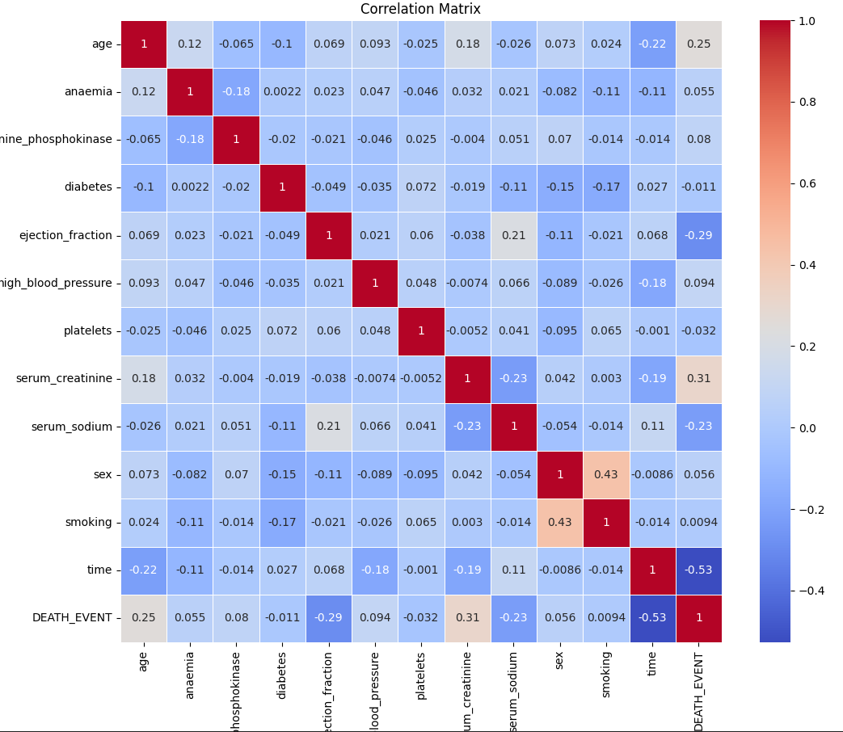

Slide 5
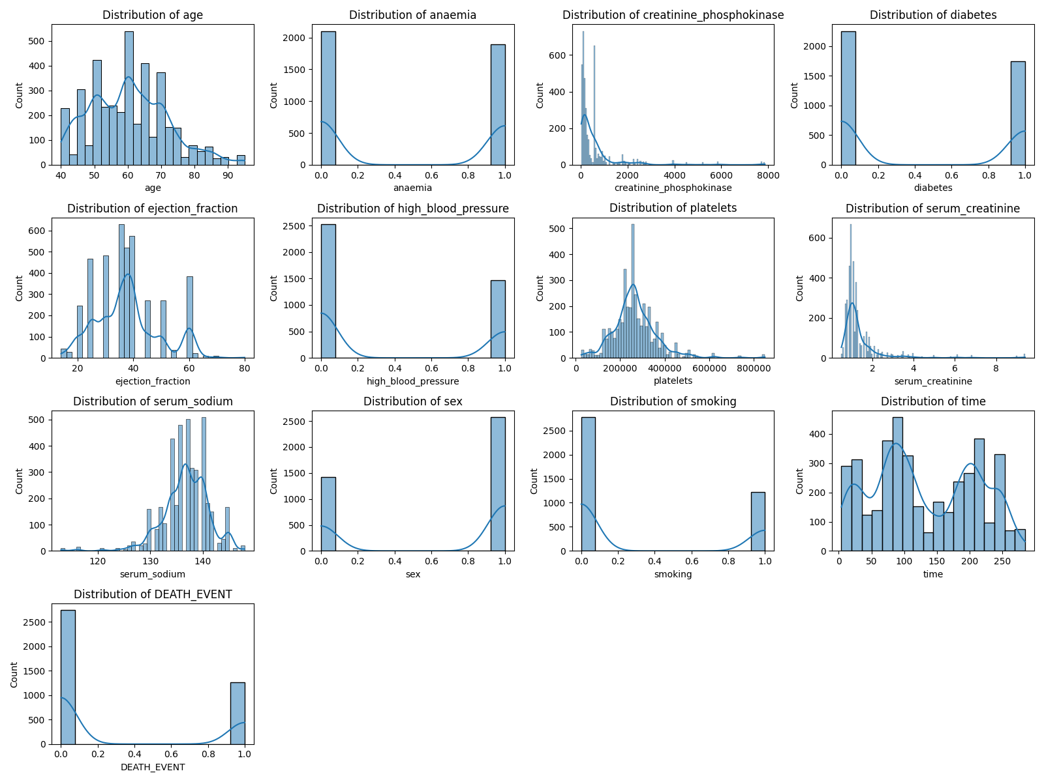
Data Distribution

Slide 6
Modals Used
Random Forest
Logistic Regression

Slide 7
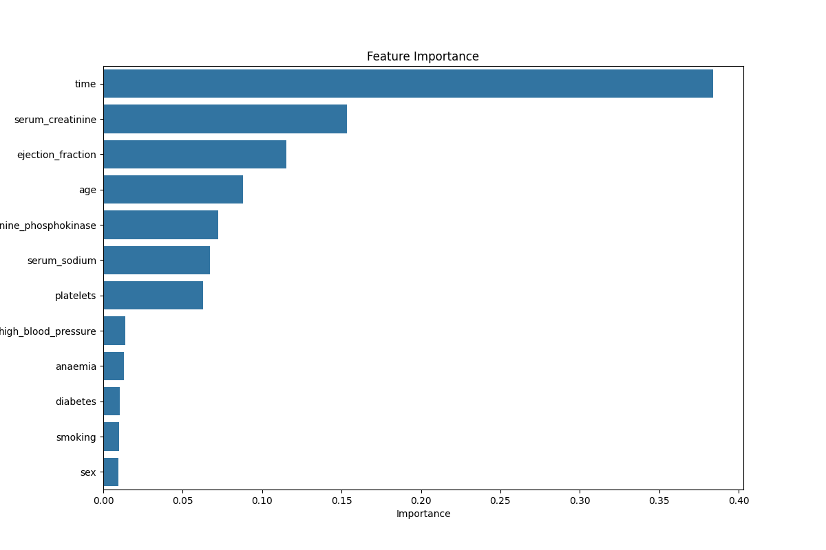
Random Forest Feature Importance

Slide 8
Random Forest Confusion Matrix
[[694 4]
[ 4 298]]
True Positives: 298 - Where the model correctly predicted the positive class.
True Negatives: 694 - Where the model correctly predicted the negative class.
False Positives: 4 - Where the model incorrectly predicted the positive class.
False Negatives: 4 - Where the model incorrectly predicted the negative class.

Slide 9
Random Forest Classification Report
The model achieves an overall accuracy of 99%.
Both classes (death event and no death event) have very high precision, recall, and F1-scores, indicating that the model is reliable in predicting both classes.
The confusion matrix corroborates the classification report, showing very few misclassifications.

Slide 10
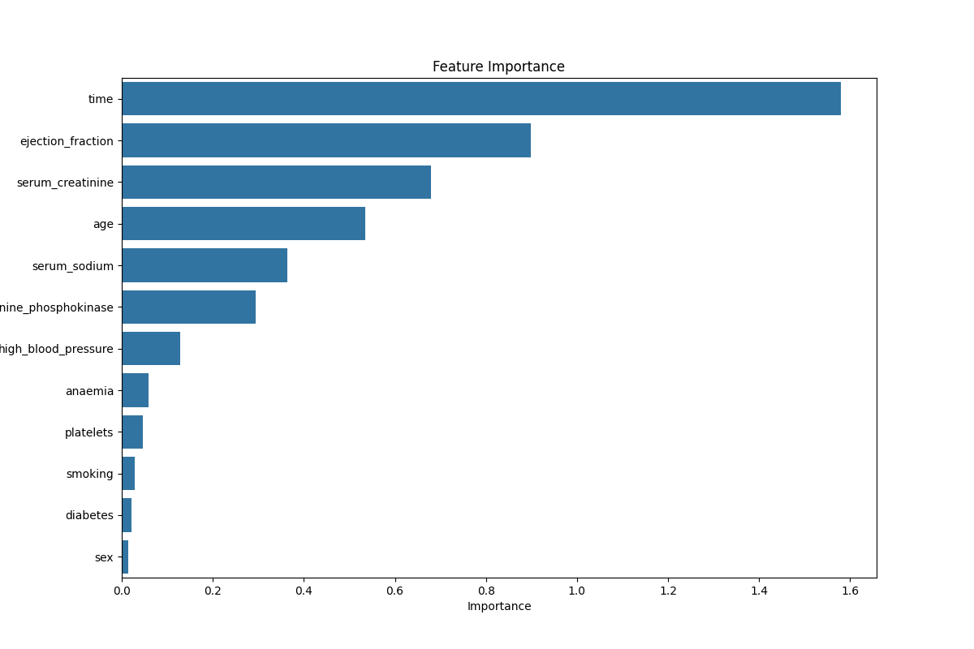
Logistic Regression Feature Importance

Slide 11
Logistic Regression Confusion Matrix
[[629 69]
[ 80 222]]
True Positives: 222 - Where the model correctly predicted the positive class.
True Negatives: 629 - Where the model correctly predicted the negative class.
False Positives: 69 - Where the model incorrectly predicted the positive class.
False Negatives: 80 - Where the model incorrectly predicted the negative class.

Slide 12
Logistic Regression Classification Report
The logistic regression model achieves an overall accuracy of 85%.
The model performs better in predicting the negative class (no death event) compared to the positive class (death event).
The model's precision, recall, and F1-scores for the positive class are lower.

Slide 13
Random Forest vs Logistic Regression
When both modals are compared, logistic regression has more misclassifications, indicating that the random forest model looks more suitable for this dataset.

